Slide 1

“The destruction of ego”
Presented by Tayab Khan.

Slide 2

Act 1: Who is Tayab Khan?
Came to this with recommendation for my brother
Was upset with current jobs and wanted a real challenge
Boy I got it
I approached the spec by going off the template given to me and trying to hit every requirement (only the requirements)

Slide 3





Act 2: Consultant Journey
Version Control System: Git
Source Code Management: GitHub
Kanban Board: Jira
Database Management System: MySQL Server 5.7+
Back-End Programming Language: Java
Build Tool: Maven
Unit Testing: JUnit

Slide 4
Act 3: Testing
Issues regarding database notwithstanding this was ok

Slide 5
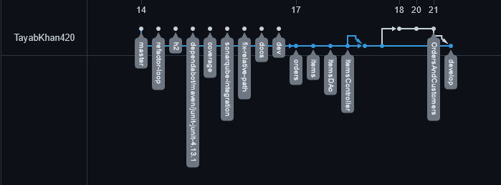
Act 4: Version Control
Feature Branch model was what I wanted
From the start I forgot about it
Caused a bunch of issues such as “lost” work
As you can see I had many issues

Slide 6
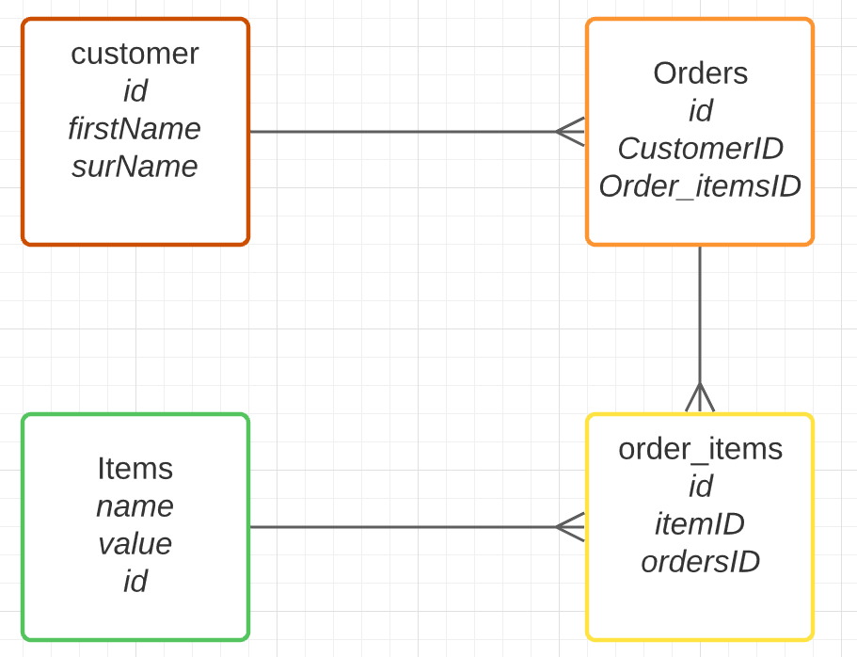
Act 5: Demonstration
Let’s move to Eclipse!

Slide 7
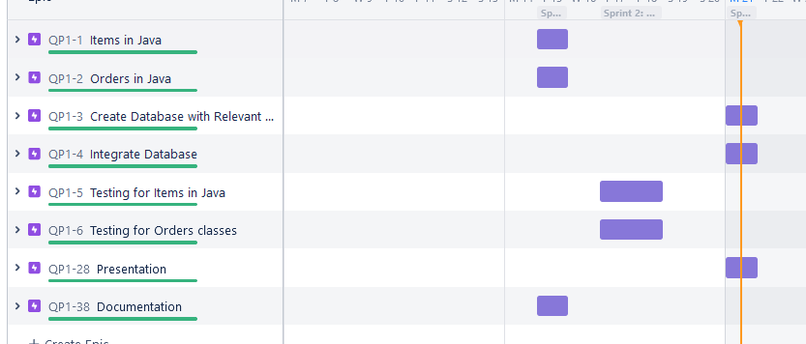
Act 6: Sprint Review

Slide 8
Act 7: Sprint Retrospective
Could have timed it better but the issues I had were more of my own accord than organisation.
I am not a fan of sprints but maybe it’s due to my own mismanagement.

Slide 9

CONCLUSION

